Slide 1
F# What’s New?

Slide 2
Topics
What is F# about?
Dig into the “interesting stuff”
Objects
Computation Expressions (aka monads)
Active Patterns
Units of Measure
Quotations
Async/Parallel

Slide 3
What is F# about?
Or: Why is Microsoft investing in functional programming anyway?

Slide 4
Simplicity

Slide 5
Economics

Slide 6
Fun! Fun! And More Fun!

Slide 7
Simplicity

Slide 8
Code!
//F#
open System
let a = 2
Console.WriteLine a
//C#
using System;
namespace ConsoleApplication1
{
class Program
{
static int a()
{
return 2;
}
static void Main(string[] args)
{
Console.WriteLine(a);
}
}
}
More Noise
Than Signal!

Slide 9

Pleasure and Pain

Slide 10
Pleasure
Pain
type Command = Command of (Rover -> unit)
let BreakCommand =
Command(fun rover -> rover.Accelerate(-1.0))
let TurnLeftCommand =
Command(fun rover -> rover.Rotate(-5.0<degs>))
abstract class Command
{
public virtual void Execute();
}
abstract class MarsRoverCommand : Command
{
protected MarsRover Rover { get; private set; }
public MarsRoverCommand(MarsRover rover)
{
this.Rover = rover;
}
}
class BreakCommand : MarsRoverCommand
{
public BreakCommand(MarsRover rover)
: base(rover)
{
}
public override void Execute()
{
Rover.Rotate(-5.0);
}
}
class TurnLeftCommand : MarsRoverCommand
{
public TurnLeftCommand(MarsRover rover)
: base(rover)
{
}
public override void Execute()
{
Rover.Rotate(-5.0);
}
}

Slide 11
Pleasure
Pain
type Expr =
| True
| And of Expr * Expr
| Nand of Expr * Expr
| Or of Expr * Expr
| Xor of Expr * Expr
| Not of Expr
public abstract class Expr { }
public abstract class UnaryOp :Expr
{
public Expr First { get; private set; }
public UnaryOp(Expr first)
{
this.First = first;
}
}
public abstract class BinExpr : Expr
{
public Expr First { get; private set; }
public Expr Second { get; private set; }
public BinExpr(Expr first, Expr second)
{
this.First = first;
this.Second = second;
}
}
public class TrueExpr : Expr { }
public class And : BinExpr
{
public And(Expr first, Expr second) : base(first, second) { }
}
public class Nand : BinExpr
{
public Nand(Expr first, Expr second) : base(first, second) { }
}
public class Or : BinExpr
{
public Or(Expr first, Expr second) : base(first, second) { }
}
public class Xor : BinExpr
{
public Xor(Expr first, Expr second) : base(first, second) { }
}
public class Not : UnaryOp
{
public Not(Expr first) : base(first) { }
}
http://stepheneasey.wordpress.com/tag/c/

Slide 12
Pleasure
Pain
let rotate (x,y,z) = (z,x,y)
let reduce f (x,y,z) =
f x + f y + f z
Tuple<V,T,U> Rotate(Tuple<T,U,V> t)
{
return new Tuple<V,T,U>(t.Item3,t.Item1,t.Item2);
}
int Reduce(Func<T,int> f,Tuple<T,T,T> t)
{
return f(t.Item1) + f(t.Item2) + f (t.Item3);
}

Slide 13
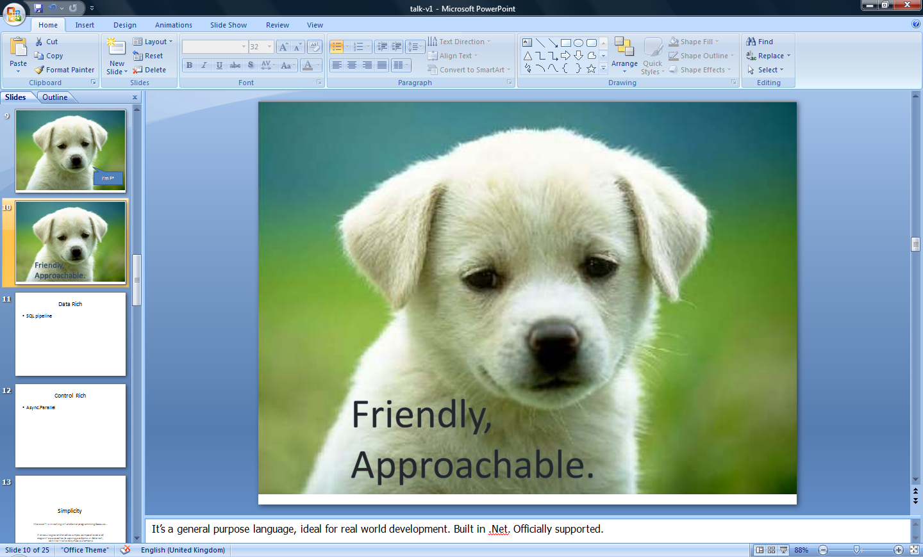


Slide 14
Economics
“Low Cost, High Value”

Slide 15
Fun! Fun! And More Fun!

Slide 16
People
Love
Programming
In
F#

Slide 17
F#: Combining Paradigms
I've been coding in F# lately, for a production task. F# allows you to move smoothly in your programming style... I start with pure functional code, shift slightly towards an object-oriented style, and in production code, I sometimes have to do some imperative programming.
I can start with a pure idea, and still finish my project with realistic code. You're never disappointed in any phase of the project!
Julien Laugel, Chief Software Architect, www.eurostocks.com

Slide 18
F#: Influences
OCaml
C#/.NET
F#
Similar core
language
Similar object
model

Slide 19
The Interesting Stuff

Slide 20
Computation Expressions

Slide 21
Computation Expressions
Give the outer control structure of this syntactic expression a monadic/
monoidal interpretation
expr = ident { expr }
cexpr; cexpr
let pat = expr in cexpr
use id = expr in cexpr
match expr with pat -> cexpr
if .. then cexpr else cexpr
try cexpr with pat -> cexpr
try cexpr finally cexpr
while ... do cexpr
for pat in ... do cexpr

Slide 22
Computation Expressions
Add extra expression forms for monadic and monoidal actions
expr = ident { expr }
| let! pat = expr
| yield expr
| return expr
| return! expr
expr; cexpr
let pat = expr in cexpr
use id = expr in cexpr
match expr with pat -> cexpr
if .. then cexpr else cexpr
try cexpr with pat -> cexpr
try cexpr finally cexpr
while ... do cexpr
for pat in ... do cexpr

Slide 23
Aims
Very Smooth Transitions to/from Monadic Code
For
Sequences
Database Queries
Asynchronous (non-blocking) Programming
“Put async { ... } around it and add let! where needed”

Slide 24
F# - Lists
Generated Lists
open System.IO
let rec allFiles(dir) =
[ for file in Directory.GetFiles(dir) do
yield file
for sub in Directory.GetDirectories(dir) do
yield! allFiles(sub) ]
allFiles(@"C:\Demo")

Slide 25
F# - Sequences
On-demand sequences
open System.IO
let rec allFiles(dir) =
seq
{ for file in Directory.GetFiles(dir) do
yield file
for sub in Directory.GetDirectories(dir) do
yield! allFiles(sub) }
allFiles(@"C:\WINDOWS")
|> Seq.take 100
|> show
Pipelines

Slide 26
type MonadBuilder() with
member Return : 'a -> M<'a>
member Delay : (unit -> M<'a>) -> M<'a>
member Bind: M<'a> * ('a -> M<'b>) -> M<'b>
let monad = MonadBuilder()

Slide 27
type AsyncBuilder() with
member Return : 'a -> Async<'a>
member Delay : (unit -> Async<'a>) -> Async<'a>
member Bind: Async<'a> * ('a -> Async<'b>) -> Async<'b>
let async = AsyncBuilder()

Slide 28
type MonadBuilder() with
member Return : 'a -> M<'a>
member Delay : (unit -> M<'a>) -> M<'a>
member Bind: M<'a> * ('a -> M<'b>) -> M<'b>
member Combine: M<unit> * M<'a> -> M<'a>
member TryFinally : M<'a> * (unit -> unit) -> M<'a>
member TryWith : M<'a> * (exn -> M<'a>) -> M<'a>
let monad = MonadBuilder()

Slide 29
Full Workflow Syntax & Translation
expr = ...
| expr { cexpr } -- let v = expr in v.Delay(fun () -> «cexpr»)
| { cexpr }
| [| cexpr |]
| [ cexpr ]
cexpr = let! pat = expr in cexpr -- v.Bind(expr,(fun pat -> «cexpr»))
| let pat = expr in cexpr -- v.Let(expr,(fun pat -> «cexpr»))
| use pat = expr in cexpr -- v.Using(expr,(fun pat -> «cexpr»))
| do! cexpr1 in cexpr2 -- «let! () = cexpr1 in cexpr2»
| do expr in cexpr -- «let () = cexpr1 in cexpr2»
| for pat in expr do cexpr -- v.For(expr,(fun pat -> «cexpr»))
| while expr do cexpr -- v.While((fun () -> expr),
v.Delay(fun () -> «cexpr»))
| if expr then cexpr else cexpr -- if expr then «cexpr1» else «cexpr2»
| if expr then cexpr -- if expr then «cexpr1» else v.Zero()
| cexpr; cexpr -- v.Combine(«cexpr1», v.Delay(fun () -> «cexpr2»))
| return expr -- v.Return(expr)
| yield expr -- v.Yield(expr)
| match expr with [pat -> cexpr]+ -- ...
| try cexpr finally cexpr -- ...
| try cexpr with pat -> cexpr -- ...

Slide 30
Objects

Slide 31
Objects
Class Types
type ObjectType(args) =
let internalValue = expr
let internalFunction args = expr
let mutable internalState = expr
member x.Prop1 = expr
member x.Meth2 args = expr
Interface Types
type IObject =
interface ISimpleObject
abstract Prop1 : type
abstract Meth2 : type -> type
Constructing Objects
new FileInfo(@"c:\misc\test.fs")

Slide 32
F# - Objects + Functional
type Vector2D(dx:double,dy:double) =
member v.DX = dx
member v.DY = dy
member v.Length = sqrt(dx*dx+dy*dy)
member v.Scale(k) = Vector2D(dx*k,dy*k)
Inputs to object construction
Exported properties
Exported method

Slide 33
F# - Objects + Functional
type Vector2D(dx:double,dy:double) =
let norm2 = dx*dx+dy*dy
member v.DX = dx
member v.DY = dy
member v.Length = sqrt(norm2)
member v.Norm2 = norm2
Internal (pre-computed) values and functions

Slide 34
F# - Objects + Functional
Immutable inputs
type HuffmanEncoding(freq:seq<char*int>) =
...
< 50 lines of beautiful functional code>
...
member x.Encode(input: seq<char>) =
encode(input)
member x.Decode(input: seq<char>) =
decode(input)
Internal tables
Publish access

Slide 35
F# - Objects + Functional
type Vector2D(dx:double,dy:double) =
let mutable currDX = dx
let mutable currDX = dy
member v.DX = currDX
member v.DY = currDY
member v.Move(x,y) =
currDX <- currDX+x
currDY <- currDY+y
Internal state
Publish internal state
Mutate internal state

Slide 36
F# Async/Parallel

Slide 37
The Philosophy
Good Architecture
Know your techniques (actors, message passing)
Know your requirements
Know your limits (CPU, disk, network, latency)
Translate Good Architecture into Good Code with F#
A great platform
Primitives for building design patterns
A massive reduction in mutation
A massive increase in isolation and clarity

Slide 38
Async: Simple Examples
Compute 22 and 7 in parallel
Async.Parallel [ async { return 2*2 + 3*6 };
async { return 3 + 5 - 1 } ]
Get these three web pages and wait until all have come back
Async.Parallel [WebRequest.Async "http://www.live.com";
WebRequest.Async "http://www.yahoo.com";
WebRequest.Async "http://www.google.com" ]

Slide 39
Units Of Measure

Slide 40
8 Ways to Learn
FSI.exe
Samples Included
Go to definition
Lutz’ Reflector
http://cs.hubfs.net
Codeplex Fsharp Samples
Books
ML

Slide 41
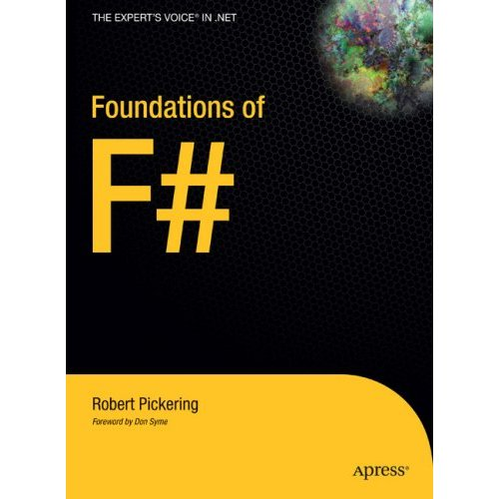
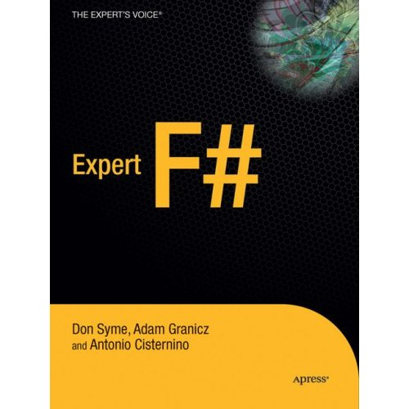
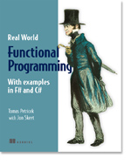

Books about F#
Visit www.fsharp.net

Slide 42
Getting F#
September 2008: CTP released
F# will be a supported language in
Visual Studio 2010
Next stop: Visual Studio 2010 Beta 1
Look for it soon!

Slide 43
Questions & Discussion

Slide 44



© 2007 Microsoft Corporation. All rights reserved. This presentation is for informational purposes only. MICROSOFT MAKES NO WARRANTIES, EXPRESS OR IMPLIED, IN THIS SUMMARY.

Slide 45
Case Study The adPredict Competition

Slide 46
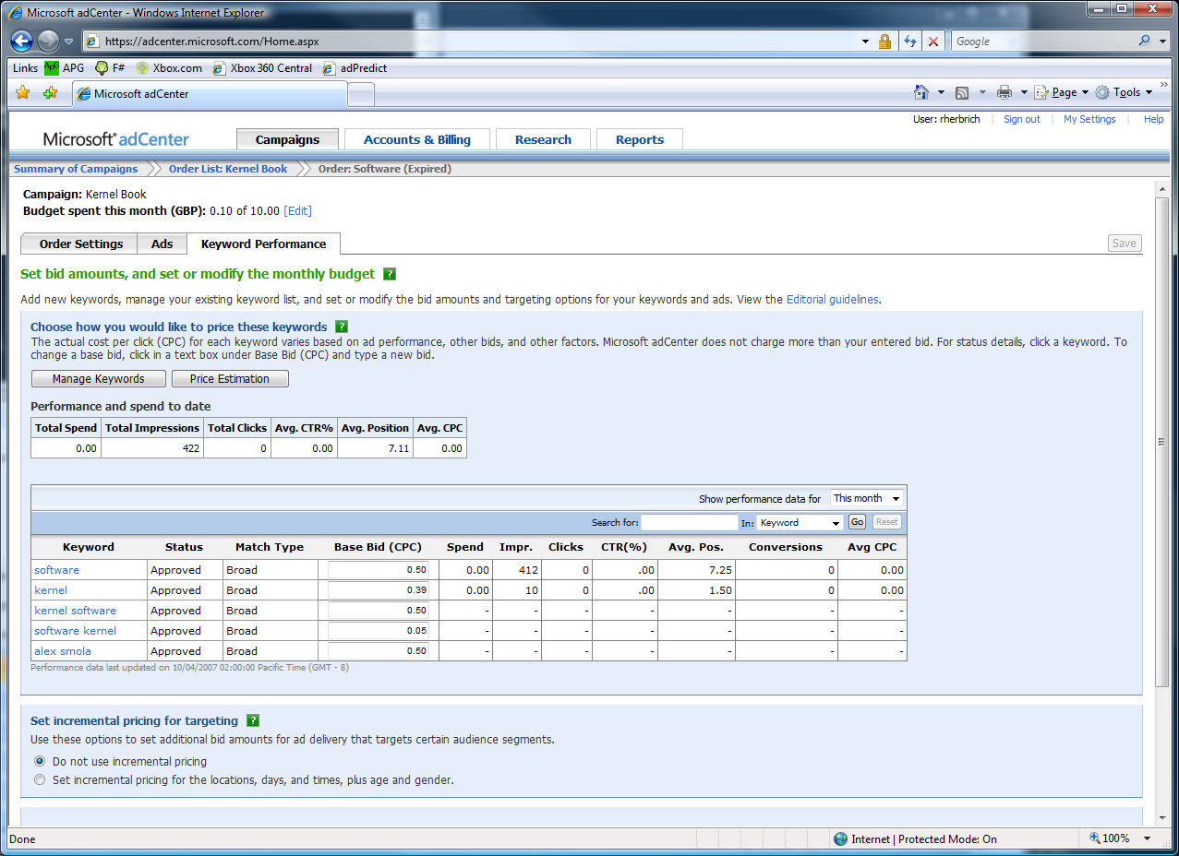

The adCenter Problem
Cash-cow of Search
Selling “web space” at www.live.com and www.msn.com.
“Paid Search” (prices by auctions)
The internal competition focuses on Paid Search.

Slide 47
The Scale of Things
Weeks of data in training:
7,000,000,000 impressions, 6TB data
2 weeks of CPU time during training:
2 wks × 7 days × 86,400 sec/day =
1,209,600 seconds
Learning algorithm speed requirement:
5,787 impression updates / sec
172.8 μs per impression update

Slide 48
F# and adCenter
4 week project, 4 machine learning experts
100million probabilistic variables
Processes 6TB of training data
Real time processing

Slide 49
AdPredict: What We Observed
F#’s powerful type inference means less typing, more thinking
Type-inferred code is easily refactored
Quick Coding
Agile Coding
Scripting
Performance
Memory-Faithful
Succinct
Symbolic
.NET Integration
“Hands-on” exploration.
Immediate scaling to massive data sets
mega-data structures, 16GB machines
Live in the domain, not the language
Schema compilation and “Schedules”
Especially Excel, SQL Server

Slide 50
F# - Concurrent/Reactive/Parallel
Concurrent: Multiple threads of execution
Parallel: These execute simultaneously
Asynchronous: Computations that complete "later"
Reactive: Waiting and responding is normal

Slide 51
Why is it so hard?
To get 50 web pages in parallel?
To get from thread to thread?
To create a worker thread that reads messages?
To handle failure on worker threads?

Slide 52
Why isn’t it this easy?
let ProcessImages() =
Async.Run
(Async.Parallel
[ for i in 1 .. numImages -> ProcessImage(i) ])

Slide 53
Taming Asynchronous I/O
using System;
using System.IO;
using System.Threading;
public class BulkImageProcAsync
{
public const String ImageBaseName = "tmpImage-";
public const int numImages = 200;
public const int numPixels = 512 * 512;
// ProcessImage has a simple O(N) loop, and you can vary the number
// of times you repeat that loop to make the application more CPU-
// bound or more IO-bound.
public static int processImageRepeats = 20;
// Threads must decrement NumImagesToFinish, and protect
// their access to it through a mutex.
public static int NumImagesToFinish = numImages;
public static Object[] NumImagesMutex = new Object[0];
// WaitObject is signalled when all image processing is done.
public static Object[] WaitObject = new Object[0];
public class ImageStateObject
{
public byte[] pixels;
public int imageNum;
public FileStream fs;
}
public static void ReadInImageCallback(IAsyncResult asyncResult)
{
ImageStateObject state = (ImageStateObject)asyncResult.AsyncState;
Stream stream = state.fs;
int bytesRead = stream.EndRead(asyncResult);
if (bytesRead != numPixels)
throw new Exception(String.Format
("In ReadInImageCallback, got the wrong number of " +
"bytes from the image: {0}.", bytesRead));
ProcessImage(state.pixels, state.imageNum);
stream.Close();
// Now write out the image.
// Using asynchronous I/O here appears not to be best practice.
// It ends up swamping the threadpool, because the threadpool
// threads are blocked on I/O requests that were just queued to
// the threadpool.
FileStream fs = new FileStream(ImageBaseName + state.imageNum +
".done", FileMode.Create, FileAccess.Write, FileShare.None,
4096, false);
fs.Write(state.pixels, 0, numPixels);
fs.Close();
// This application model uses too much memory.
// Releasing memory as soon as possible is a good idea,
// especially global state.
state.pixels = null;
fs = null;
// Record that an image is finished now.
lock (NumImagesMutex)
{
NumImagesToFinish--;
if (NumImagesToFinish == 0)
{
Monitor.Enter(WaitObject);
Monitor.Pulse(WaitObject);
Monitor.Exit(WaitObject);
}
}
}
public static void ProcessImagesInBulk()
{
Console.WriteLine("Processing images... ");
long t0 = Environment.TickCount;
NumImagesToFinish = numImages;
AsyncCallback readImageCallback = new
AsyncCallback(ReadInImageCallback);
for (int i = 0; i < numImages; i++)
{
ImageStateObject state = new ImageStateObject();
state.pixels = new byte[numPixels];
state.imageNum = i;
// Very large items are read only once, so you can make the
// buffer on the FileStream very small to save memory.
FileStream fs = new FileStream(ImageBaseName + i + ".tmp",
FileMode.Open, FileAccess.Read, FileShare.Read, 1, true);
state.fs = fs;
fs.BeginRead(state.pixels, 0, numPixels, readImageCallback,
state);
}
// Determine whether all images are done being processed.
// If not, block until all are finished.
bool mustBlock = false;
lock (NumImagesMutex)
{
if (NumImagesToFinish > 0)
mustBlock = true;
}
if (mustBlock)
{
Console.WriteLine("All worker threads are queued. " +
" Blocking until they complete. numLeft: {0}",
NumImagesToFinish);
Monitor.Enter(WaitObject);
Monitor.Wait(WaitObject);
Monitor.Exit(WaitObject);
}
long t1 = Environment.TickCount;
Console.WriteLine("Total time processing images: {0}ms",
(t1 - t0));
}
}
let ProcessImageAsync () =
async { let inStream = File.OpenRead(sprintf "Image%d.tmp" i)
let! pixels = inStream.ReadAsync(numPixels)
let pixels' = TransformImage(pixels,i)
let outStream = File.OpenWrite(sprintf "Image%d.done" i)
do! outStream.WriteAsync(pixels')
do Console.WriteLine "done!" }
let ProcessImagesAsyncWorkflow() =
Async.Run (Async.Parallel
[ for i in 1 .. numImages -> ProcessImageAsync i ])
Processing 200 images in parallel

Slide 54

F# - Functional + Queries
SQL <@ { for customer in db.Customers do
for employee in db.Employees do
if customer.Name = employee.Name then
yield (customer.Name, employee.Address) } @>
SQL : Expr<seq<'a>> -> seq<'a>
LINQ SQLMetal
SQL Database

Slide 55
Some Foundation Technologies
.NET/Win32 Threads
System.Threading
.NET Thread Pool
.NET BackgroundWorker and SynchronizationContexts
Parallel Extensions for .NET

Slide 56
F# - Concurrent/Reactive/Parallel
Concurrent: Multiple threads of execution
Parallel: These execute simultaneously
Asynchronous: Computations that complete "later"
Reactive: Waiting and responding is normal

Slide 57
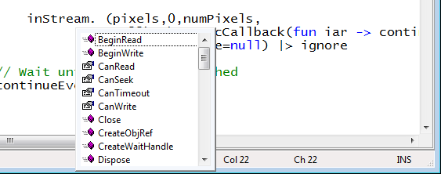
Taming Asynchronous I/O
Target: make it easy to use Begin/End operations
Stream.BeginRead : ...
Stream.EndRead : IAsyncResult * ...

Slide 58
Quick Tour: Types
Basic Types and Literals
sbyte = System.SByte 76y
byte = System.Byte 76uy
int16 = System.Int16 76s
uint16 = System.UInt16 76us
int32 = System.Int32 76
uint32 = System.UInt32 76u
int64 = System.Int64 76L
uint64 = System.UInt64 76UL
string = System.String "abc", @"c:\etc"
single = System.Single 3.14f
double = System.Double 3.14, 3.2e5
char = System.Char '7'
nativeint = System.IntPtr 76n
unativeint = System.UIntPtr 76un
bool = System.Boolean true, false
unit = Microsoft.FSharp.Core.Unit ()
Basic Type Abbreviations
int8 = sbyte
uint8 = byte
int = int32
float32 = single
float = double

Slide 59
Taming Asynchronous I/O
Typical Control Flow
Compositional
thread-hopping?
BeginRead
EndRead
Rest of Task

Slide 60
Taming Asynchronous I/O
ReadAsync
Rest of Task

Slide 61
F# - Imperative + Functional
Using .NET collections
open System.Collections.Generic
let dict = new Dictionary<int,string>(1000)
dict.[17] <- "Seventeen"
dict.[1000] <- "One Grand"
for (KeyValue(k,v)) in dict do
printfn "key = %d, value = %s" k v

Slide 62
F# - Imperative + Functional
“use” =
C# “using”
open System.IO
open System.Collections.Generic
let readAllLines(file) =
use inp = File.OpenText file
let res = new List<_>()
while not(inp.EndOfStream) do
res.Add(inp.ReadLine())
res.ToArray()

